Slide 1


Teaching English in Korea
A DOORWAY TO YOUR LIFE

Slide 2
What starts as a gap year can become something you never expected.

Slide 3
3 Tales

Slide 4
ALEX CHUNG
Durban

Slide 5


Slide 6
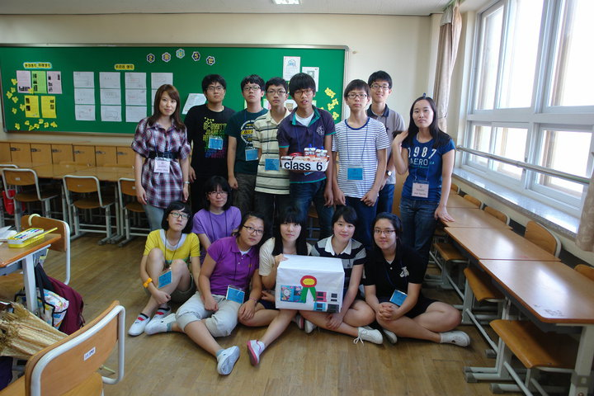

Slide 7
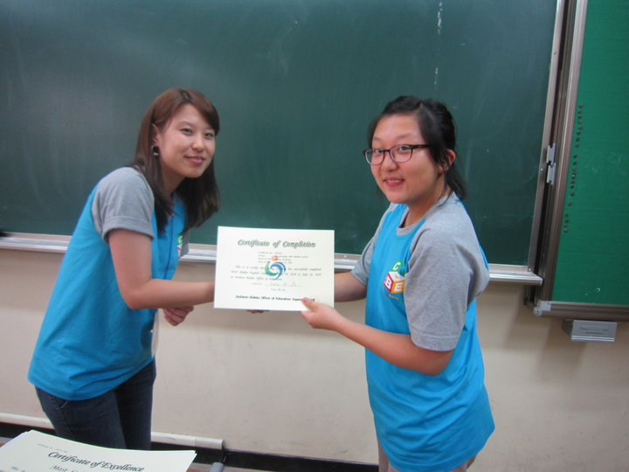

Slide 8


Slide 9
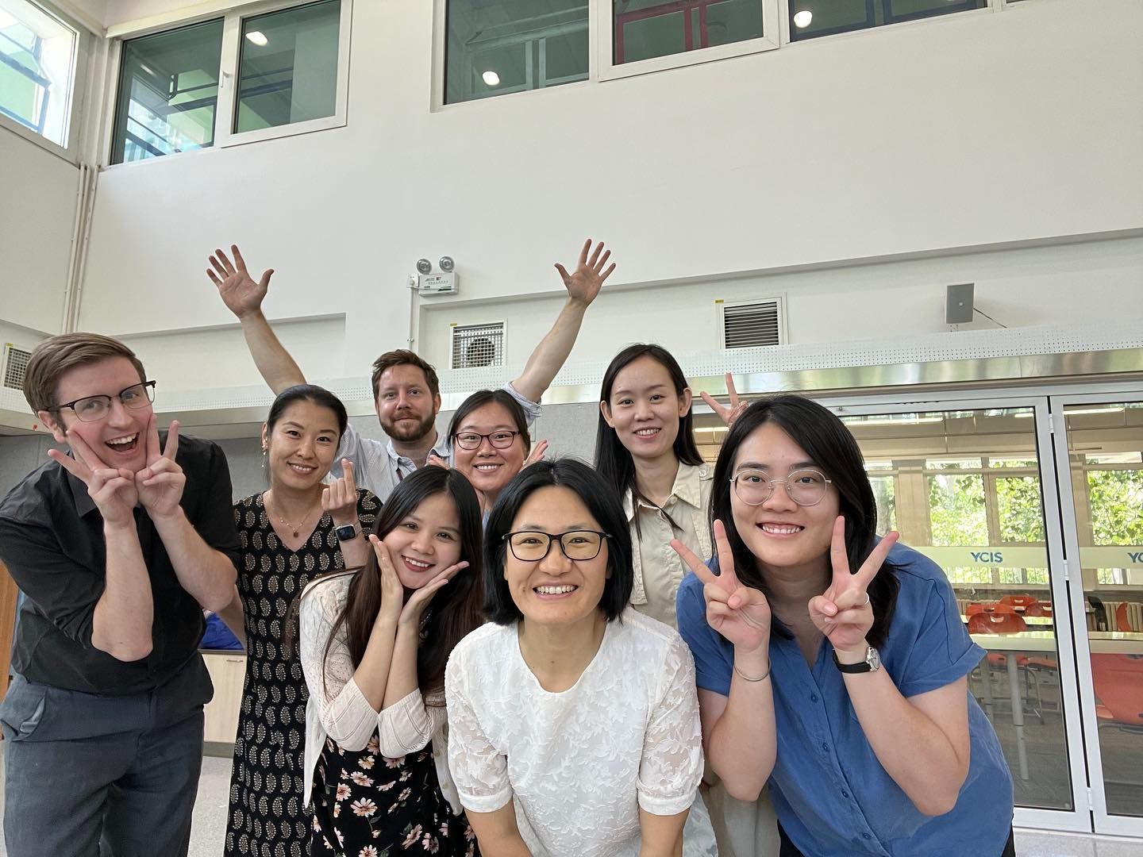

Slide 10
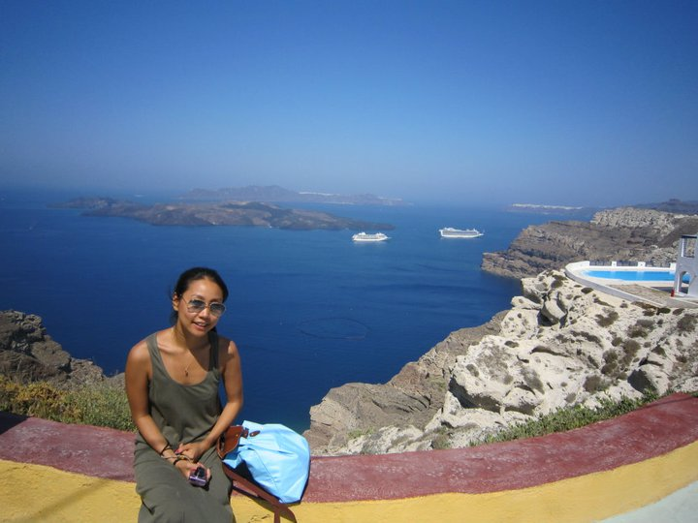

Slide 11
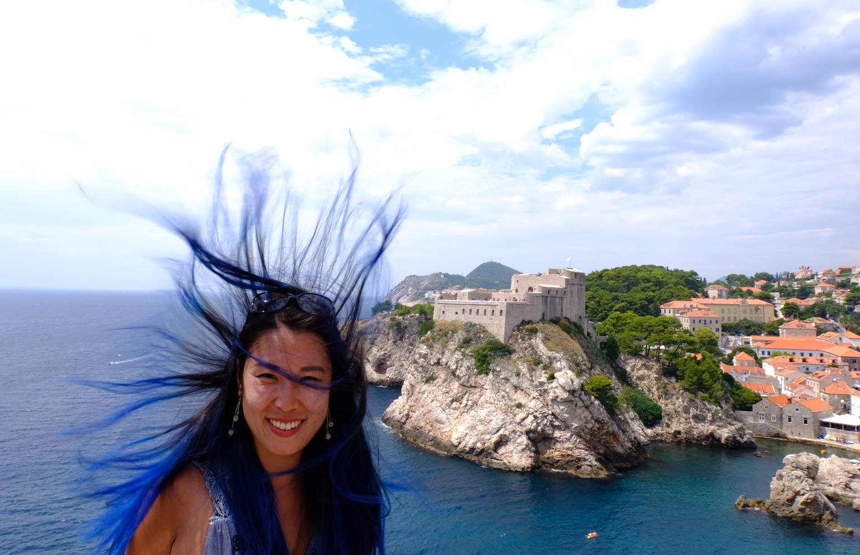

Slide 12
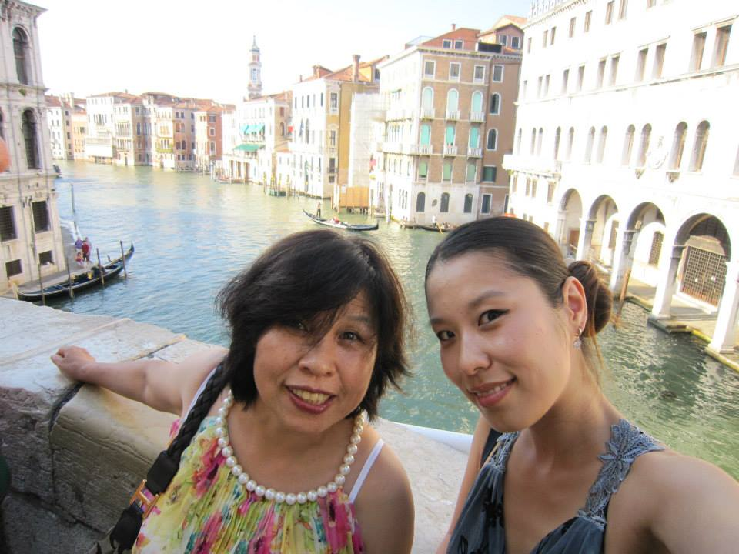

Slide 13
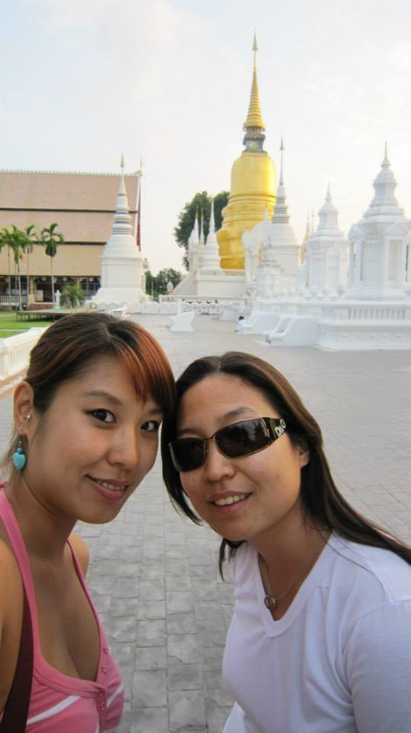

Slide 14
CHE UPTON
Johannesburg

Slide 15
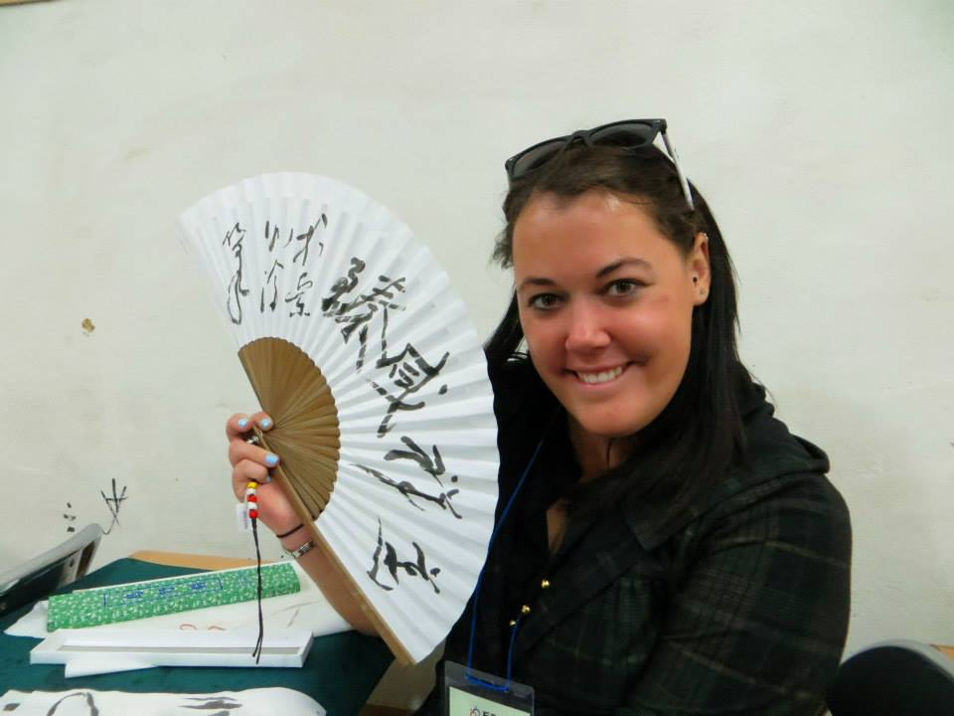

Slide 16
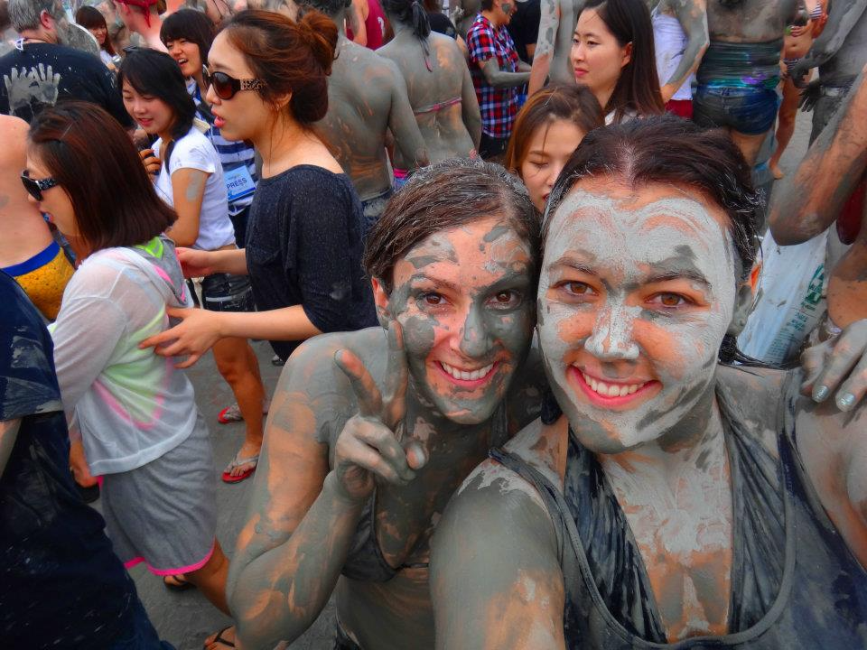

Slide 17


Slide 18


Slide 19
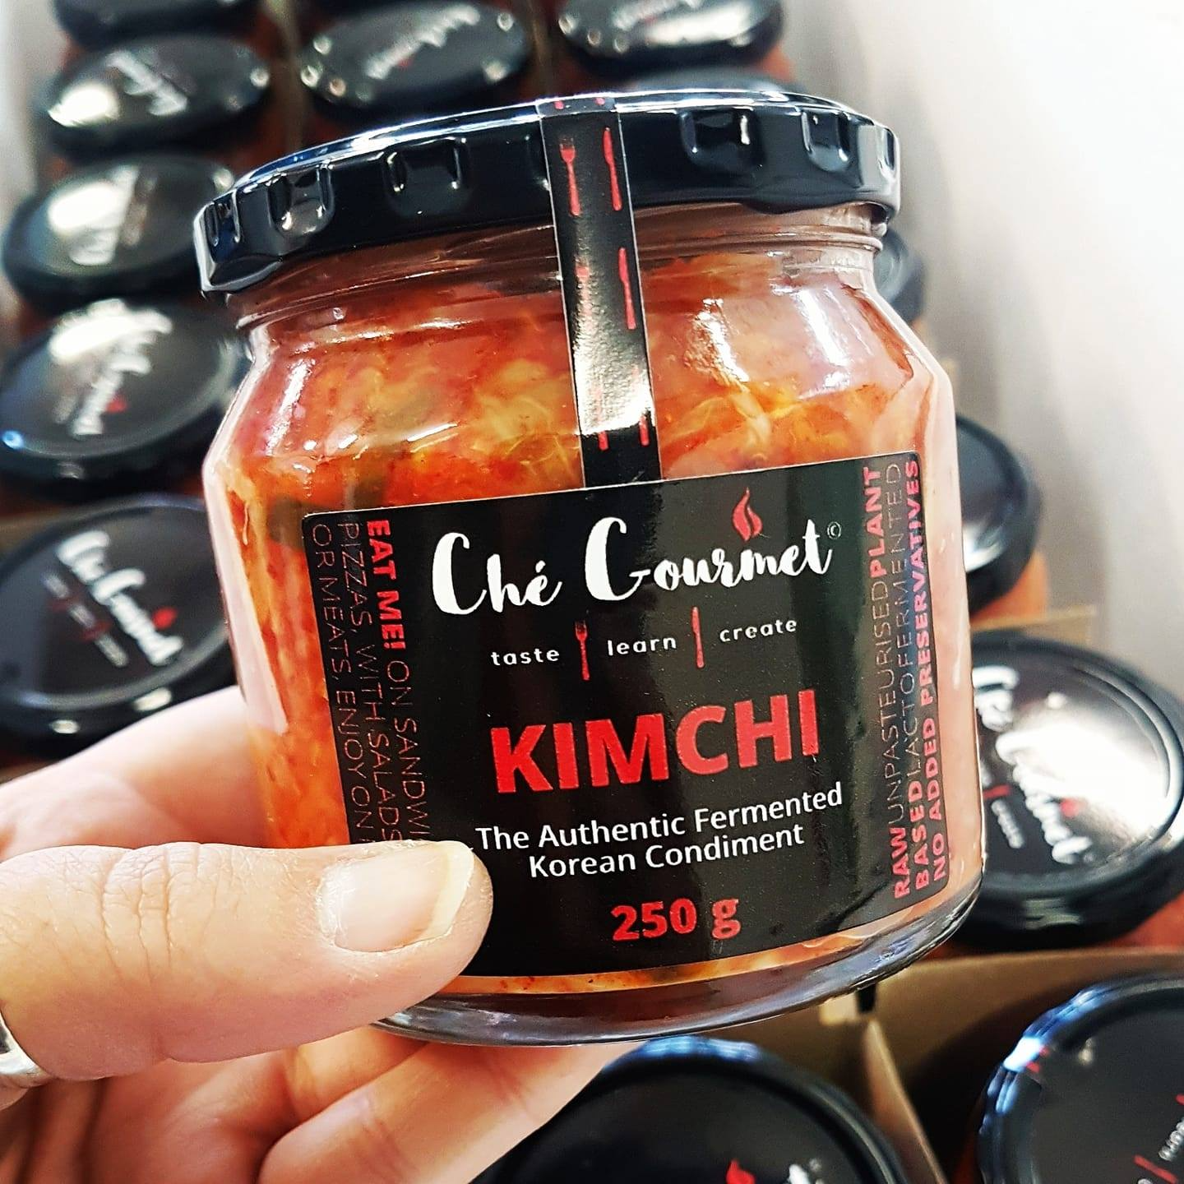
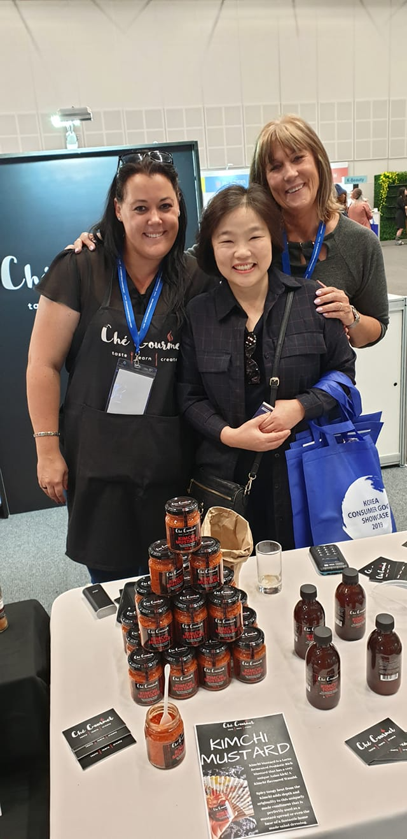

Slide 20
MATTHEW ASHLEY
Cape Town

Slide 21


Slide 22
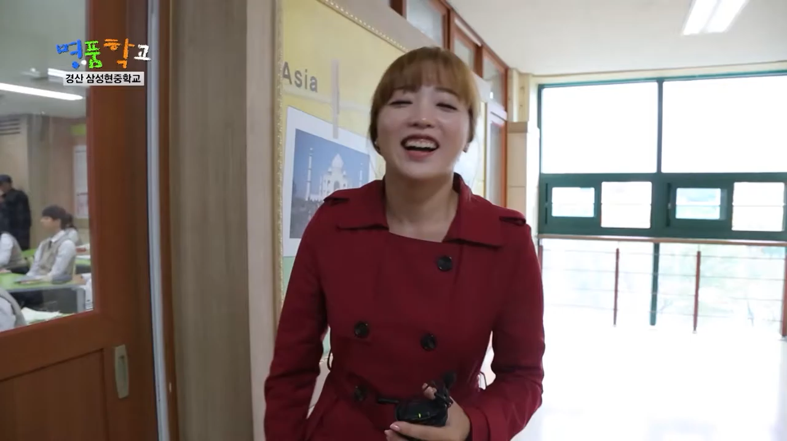

Slide 23
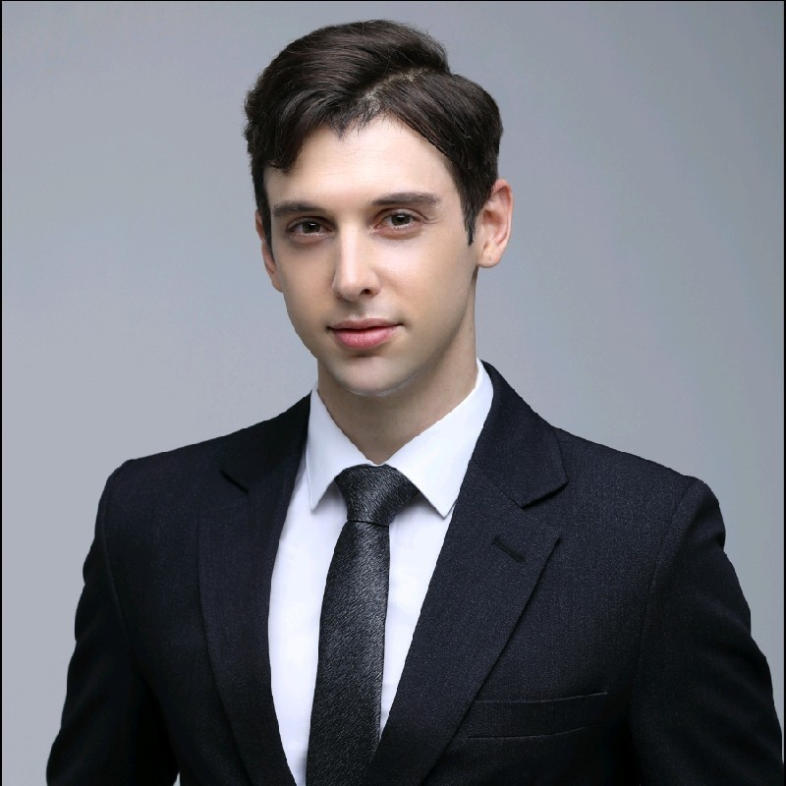

Slide 24


Slide 26
Thank You

